Slide 1
Meeting Week 4
Last week summary
OMNIPUS and alternative
Simulation
Question 1
Outline ToDo next week

Slide 2
Last week summary
Combining Bas Kessels his Extension and Augmentation with Orthogonality Regularization
  Extension: New states are added to the model to capture unmodeled dynamics
  Augmentation: Existing state derivative and output equations of the FP model are augmented with NNs
  Orthogonality Regularization: Penalizes the neural network from learning dynamics explained by the FP model
    Restricts the NN so it is forced to learn unmodeled "leftover" dynamics
    Preservers interpretability

Slide 3
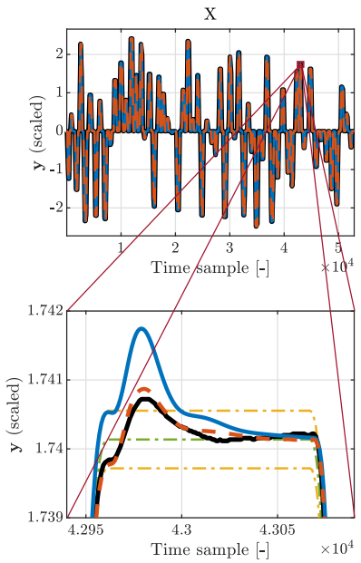
Last week summary
Key metric to design experiments around: settling error bounds
  Weighting function to tell the optimizer where accuracy matters → acts as prefilter
    Specify frequencies where accuracy matters most
  Proposed cost function instead of Feature selection from Kessels for the peaks
    Can we actually rule out Time Extremum (peaks and valley) features for dual-gantry?
Measured system – black
FP model – blue
EA model – red
Reference profile – green
Error bounds – yellow

Slide 4
Feature selection not applicable
FS is made for a “one-shot” model (IMPU): Compress a full measurement into a few features and predict parameters.
EA is a “step-by-step” simulator: at every time step it needs the current state and input ((x_k, u_k)) to compute the next state (x_{k+1}). Replacing the time series by a few features, the simulator no longer has the information it needs to run.
Orthogonality works per time step: it checks at each ((x_k,u_k)), that the NN adds only what the FP model cannot explain. With only global features, we can’t do this point-by-point check.
In short: architectural mismatch

Slide 5
Last week summary
Experiment design
  Wet-clutch “spike” signal to capture local dynamics
  OMNIPUS for global movement to cover full operating space

Slide 6
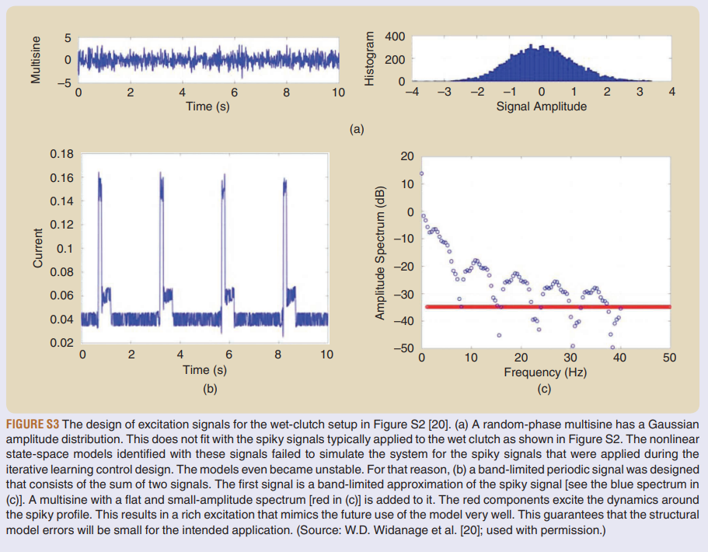
Random multisine (a) is smooth/gaussian → not like real wet-clutch spikes → model fails on spikes.
Fix (b–c): use band-limited spike-like input + small flat multisine (red) to excite extra frequencies around the spike path.

Slide 7
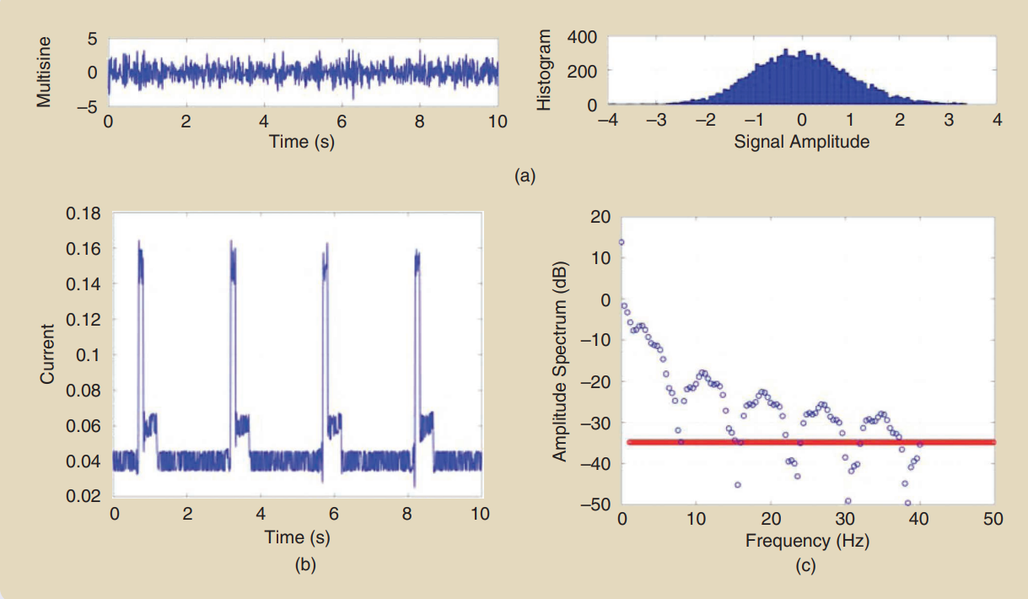
FIGURE S3 The design of excitation signals for the wet-clutch setup in Figure S2 [20]. (a) A random-phase multisine has a Gaussian amplitude distribution. This does not fit with the spiky signals typically applied to the wet clutch as shown in Figure S2. The nonlinear state-space models identified with these signals failed to simulate the system for the spiky signals that were applied during the iterative learning control design. The models even became unstable. For that reason, (b) a band-limited periodic signal was designed that consists of the sum of two signals. The first signal is a band-limited approximation of the spiky signal [see the blue spectrum in (c)]. A multisine with a flat and small-amplitude spectrum [red in (c)] is added to it. The red components excite the dynamics around the spiky profile. This results in a rich excitation that mimics the future use of the model very well. This guarantees that the structural model errors will be small for the intended application. (Source: W.D. Widanage et al. [20]; used with permission.)

Slide 8
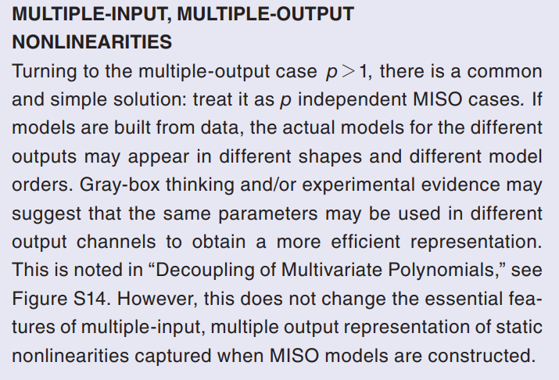
OMNIPUS for MIMO?
Book Schoukens: only discussed OMNIPUS in the context of MISO
Book provides a general principle for nonlinear system identification handles multiple outputs
For multiple outputs, we often just fit one MISO nonlinear model per output; the outputs may need different model orders, and sometimes we can share parameters across outputs for efficiency, but the basic MIMO behavior is already captured by the set of MISO models

Slide 9
OMNIPUS with constraints

Slide 10
Alternatives to OMNIPUS
For the dual-gantry system need a method that keeps collisions and thus input constraints into account for global excitation.
  MIMO methods designed for this?

Slide 11
RHC-Based Space-Filling Input Design for Nonlinear Systems
Problem: standard input designs overlook the generalization error (model inaccuracies in unexplored operating regions)
Core solution: optimization framework that actively drives the system to "fill the space" of a user-defined region of interest, minimizing knowledge gaps
  Uses a Receding Horizon Control (RHC) strategy to iteratively predict and optimize future input sequences
  Minimizes the distance between the signal's data points and a uniformly distributed "supporting dataset“ (acts as an ideal target map or grid that guides the algorithm to ensure it explores the entire operational space of the system) within the model's input space
  Strict safety guarantees: Mathematically enforces hard constraints on both inputs and system states, preventing operation in undesirable or blocked regions
Paper: Online and Offline Space-Filling Input Design for Nonlinear System Identification: A Receding Horizon Control-Based Approach
Notes:
Can be executed Offline (using a fixed, coarse surrogate model) or Online (adaptively updating the model as data is collected)
Introduction & The Problem "This paper addresses a major flaw in traditional data-driven modeling: the generalization error. If our excitation signal doesn't visit a specific region of the operating space, our nonlinear model will likely fail in that region. We need a signal that explicitly explores everywhere."
The Methodology "To solve this, the authors propose a 'space-filling' design. Instead of just injecting random noise, they use a Receding Horizon Control (RHC) optimization framework. Essentially, the algorithm looks at the data points it has already collected, looks at a grid of target 'anchor points' distributed evenly across the desired operating space, and mathematically calculates the optimal next inputs to fill in the empty gaps."
Why it Matters for Our System (Safety & Flexibility) "There are two massive benefits to this approach for our specific needs. First, because it uses RHC, we can define strict, mathematical hard constraints on both the inputs and the system states. This guarantees the system will not try to drive into a physical collision or a blocked region. Second, it is highly flexible; we can run it purely offline using a rough baseline model, or we can run it online so it adapts its exploration as it learns the true system dynamics."
Conclusion "Ultimately, the paper proves that this method significantly outperforms standard excitation signals—like APRBS—in uniformly mapping a nonlinear system's dynamics, resulting in a robust model that generalizes safely across the entire operational envelope."

Slide 12
FRF method
FRF not as useful for finding global dynamics
  Because
Constraints could be used

Slide 13
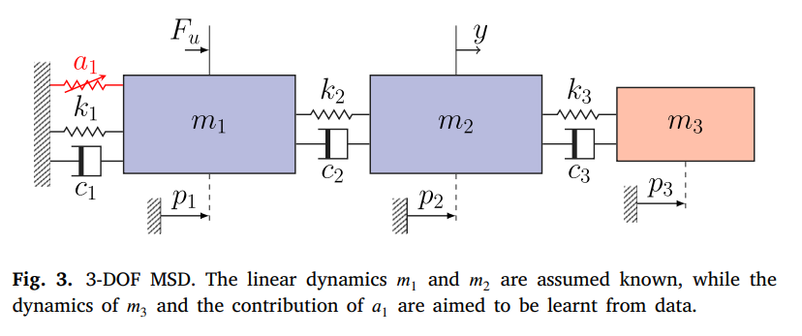
Simulation
Mass Spring Damper system: dynamics of the third (red) mass block and a nonlinear cubic spring (a1) attached to the known modeled system.
Baseline Model: The code assumes we only have an imperfect, simplified physical model: linear 2-DOF system that only takes the first two masses into account

Slide 14
Model augmenation
Model augmentation: combines the simplified physics model with Artificial Neural Networks (ANNs) to bridge the gap between data and FP model
  Adds two new mathematical states to the baseline model for the missing third mass
  It uses neural networks to learn only the unmodeled dynamics. Prevents this with Parameter Regularization: penalizes the model if the parameters of the baseline physics model (the known masses and springs) drift too far from their initial values
  LFR Structure: Connects the neural networks and the physical model using a Linear Fractional Representation (LFR) structure
    Allows to operate in parallel or series

Slide 15
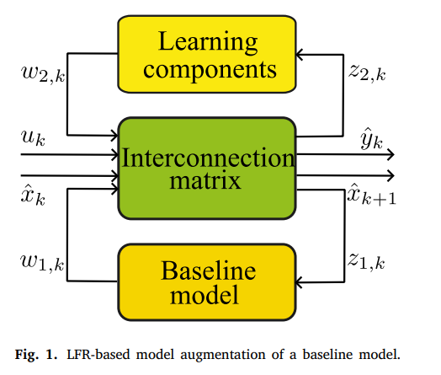
Linear Fractional Representation (LFR)
Learning components = neural network
Interconnection matrix: acts as routing switchboard, determines how the physics and NN interact with each other
LFR switchboard: at each time step
  Inputs: takes the current state of the system (x^k​), the external force/input (uk​), and the outputs generated by both the physics model (w1,k​) and the neural networks (w2,k​)
  Routing: Based on matrix configuration, it decides what signals to feed back into the physics model (z1,k​) and what signals to feed into the neural networks (z2,k​) for the next calculation
  Output: combines all these signals to calculate the system's overall next state (x^k+1​) and the predicted output (y^​k​)

Slide 16
Interconnection Matrix (S)
Only job of S is to direct the flow of the data between the physical model and the neural network
Parallel (allows to use orthogonality)
  S treats the physical model and the neural network as two independent workers tackling the same problem at the same time
  ANN learns the residual dynamics missing from the baseline
  Outputs simply added together
Series (sequential, not acting independently)
  S first sends the current state and input only to the physics model → routes this output directly into the neural network as its inputs
  ANN learns a correction map on top of the baseline’s predicted next-state, rather than an additive residual

Slide 17
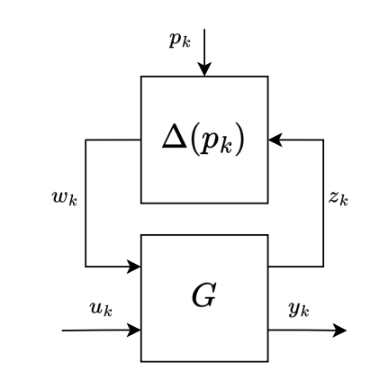
Adapt simulation code for MIMO & LPV
Need to adapt the current SISO code to work for MIMO and adapt it to work for Linear Parameter Varying (LPV)
LPV
  LPV-LFR (the physics): Separates the system into a baseline linear model and a parameter-varying “delta block" (Δ(pk​)). The delta block continuously shifts the linear model's equations to capture nonlinear behavior
  Scheduling Map Network (NN): Additional Neural Network does not predicts the physical dynamics directly. Instead acts as a "conductor."
    Input: It observes the current environment (states, inputs, and exogenous signals).
    Output: It outputs dynamic tuning dials (scheduling variables, pk​)
    Result: These pk​ variables are fed directly into the delta block, telling the LPV-LFR model exactly how to adjust its physics for that time step
    (can still have another NN augmentation in parallel/series predicting residual dynamics)

Slide 18
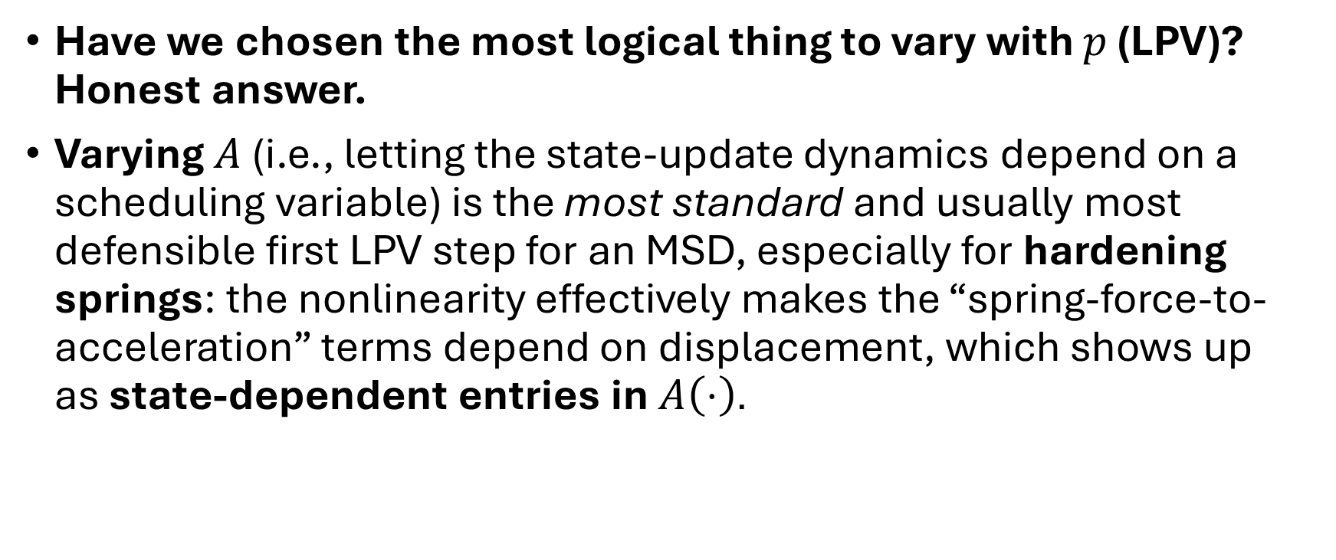
Adapt to Linear Parameter Varying (LPV)
Have we chosen the most logical thing to vary with $p$ (LPV)? Honest answer.
Varying $A$ (i.e., letting the state-update dynamics depend on a scheduling variable) is the most standard and usually most defensible first LPV step for an MSD, especially for hardening springs: the nonlinearity effectively makes the “spring-force-to-acceleration” terms depend on displacement, which shows up as state-dependent entries in $A\left(⋅\right)$.

Slide 19
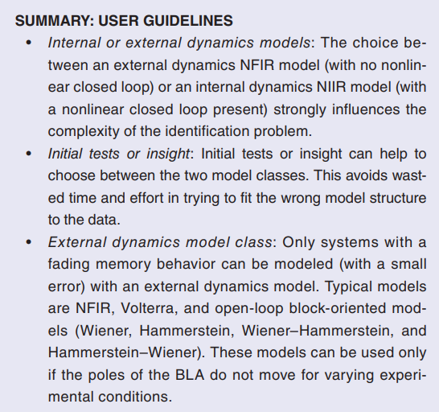
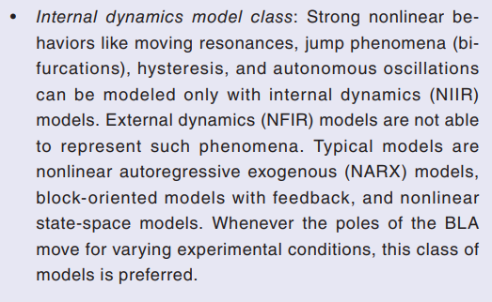
Nonlinear Infinite Impulse Response (NIIR)
third type of model mismatch is missing states. In this case, the physical system exhibits dynamical behavior that operates on additional, different timescales (or for linear systems; eigenfrequencies) than those already present in the FP model. These may be caused by, among others, flexible dynamics and parasitic degrees of freedom. To account for this type of model mismatch, completely new states are required, which also require their own governing dynamical state equations, i.e., state extension is applied. To this end, again, NNs are employed.
The governing dynamical state equations are captured by separate NNs. Here, we have the choice to use physical knowledge and assume that these equations take on a second-order structure to limit the workload of the neural network. In this chapter, we indeed will assume a second-order structure for the extended states.
"Internal Dynamics"—specifically unmodeled resonances or flexible modes-that cannot be represented by a simple history of inputs
The most direct justification is that the physical phenomena you are trying to learn (e.g., flexible modes of the gantry) have their own "memory" or inertia.
Notes:
• Concept: Kessels defines these unmodeled phenomena as "missing states". A state, by definition, summarizes the past history of the system [Source 5, 206].
• Justification: If you simply map Input → Output (Feedforward), you assume the system reacts instantly or with a fixed finite delay. However, a flexible mode continues to oscillate after the input has stopped. To model this, the system must know its current status (position/velocity of the vibration) to calculate its next step.

Slide 20
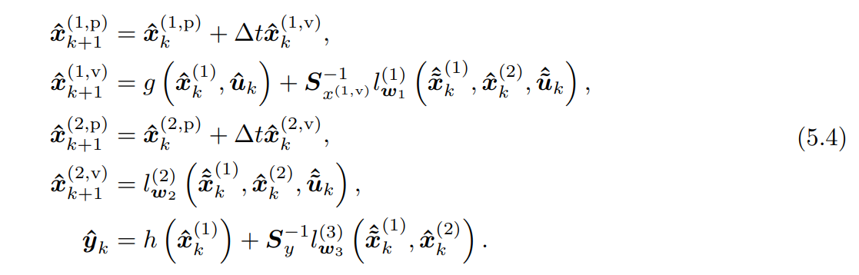
lw(i) represents a feedforward nn parameterized by weights w
Calculates how the system changes from one time step to the next
Since for a simulation, l (1) w1 , l (2) w2 , and l (3) w3 are used recurrently in sequential time steps, they are regarded as Recurrent Neural Networks (RNNs)
The "recurrent" label comes from where l is placed in the equations, not the internal architecture of the network itself. l acts as the state transition function (or discrete vector field) for the augmented parts of the model.
Update Xk+1 and update lw based on states. So why update twice?
The 3 l’s are trained static mapping. Feed forward nn, but because these 3 nn (l’s) keep looping back in (the total picture where all 3 are combined). He calls it a RNN. So for the augmentation step the l’s are a static mapping
Kijken hoe de l’s precies getraint.

Slide 21
3. Specific Roles of each l function
Kessels defines three distinct l functions, each serving a different purpose in the Extension and Augmentation (EA) model [Source 5, 343, 344]:
• lw1​(1)​ (Augmentation):
◦ Job: Corrects the known physics.
◦ Action: It calculates a "correction force" that is added to the standard First Principles equation (g). For example, if the FP model predicts friction incorrectly, l(1) learns to output the missing friction force.
• lw2​(2)​ (Extension):
◦ Job: drives the new physics.
◦ Action: It acts as the entire physics engine for the "missing states" (like flexible modes). It calculates the acceleration of these invisible states based on the system's current motion.
• lw3​(3)​ (Output Correction):
◦ Job: Corrects the sensor reading.
◦ Action: It maps the internal states to the measured output. If the sensor has a nonlinearity not modeled by h, l(3) adds a correction value to the output y^​.

Slide 22
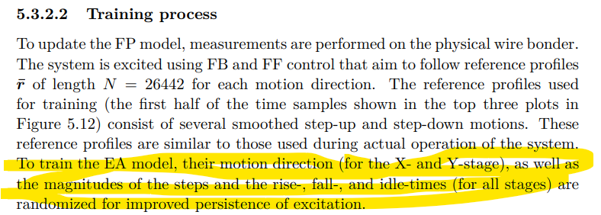
Global movement
OMNIPUS responsible for global movement for covering the full operating space. Combine with “Wet-Clutch Trick” for local excitation
OMNIPUS was for three inputs and one output → MIMO
MIMO nonlinear sytem identifciation literature.Compare to how Kessels did it.
  The "OMNIPUS" Aspect: Instead of using a fixed repetitive cycle, Kessels explicitly randomizes the "motion direction... as well as the magnitudes of the steps".
OMNIPUS: As described in Source 0, OMNIPUS involves an optimization routine (often brute-force) to select the specific sequence of steps that maximizes the information content (Fisher information matrix)
Hoe experiment voor dual gantry. Hoe houd je rekening met dat het systeem niet botst. Kunt niet omnipus gwn random steps. Constrain the inputs, of iets slimmers?

Slide 23
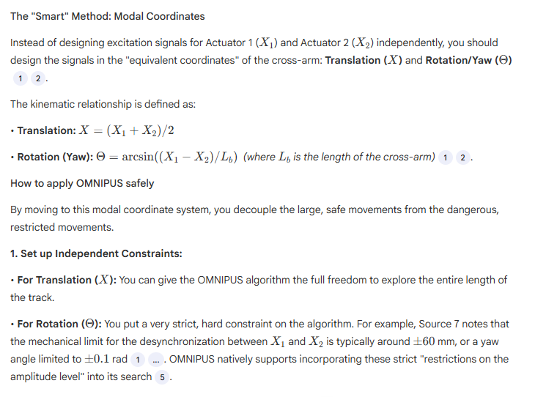
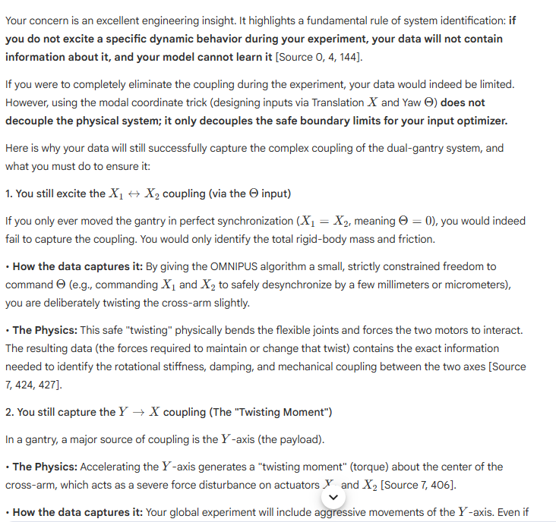
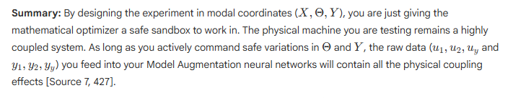
The thing is i have two gantries (its a dual gantry system). So i cant just use omnipus i need an algorithm/method that keeps in mind they gantries can physically collide. So either i need to put constraints on the inputs, but this limits the search algorithm, or i need a smart algorithm that keeps this in mind.
But I cannot just ignore the coupling… so modal transformations don’t seem to be the solution…

Slide 24
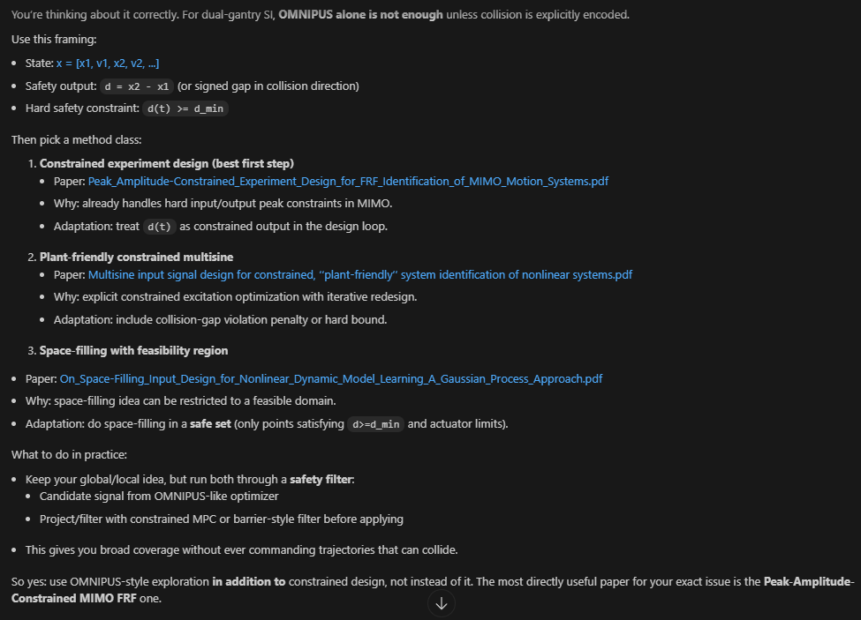
but if i just use a "filter" on the omnipus the algorithm might not cover all the space and miss important dynamics during training. so I should have a smarter method than just constraining the inputs.

Slide 25
Usefulness for your case:
Peak_Amplitude-Constrained...: very useful globally for safe MIMO FRF campaigns (include collision-gap as constrained output).
Multisine plant-friendly...: useful globally/semi-global for constrained nonlinear excitation design.
On_Space-Filling...: useful globally for coverage strategy, but only after embedding your safe feasible set.
Designing positive excitation...: situational; useful if you have one-sided actuation/drift-like constraints, otherwise secondary.
And yes:
Use the above as global safe excitation framework.
Then use a wet-clutch-style local excitation/refinement near critical regions (small gap, high coupling, resonance zones, endpoint trajectories).
So your proposed architecture is solid:
Safe constrained global design.
Targeted local refinement for high-sensitivity dynamics.

Slide 26
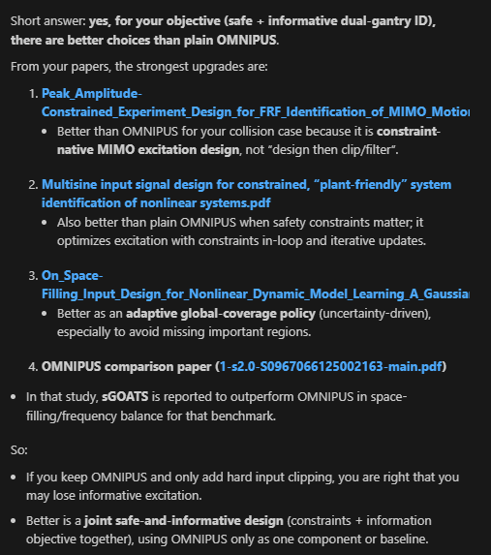
Better than OMNIPUS for dual-gantry
Problem with OMNIPUS: limit constrains
  Could use modal decoupling for inputs → still triggers coupled dynamics? Do I have a paper for this?
If we limited the inputs to OMNIPUS which does work for MIMO because: …
Just constraining the inputs might miss important dynamics, smarter methods:
    Analysis of space-filling excitation signals and dynamic models for nonlinear
    system identification of dynamic processes of a Diesel engine. Finds sGoats to be better but this is not a coupled system → should I do comparative excitation study? → better to pick one or two, since that is not the main goal of my project…
    → Pick a literature-backed safe default for global data collection. Goal of the project is model augmentation / grey box

Slide 27
Constrained MIMO FRF excitation design as the base
Use Peak_Amplitude-Constrained_... style design (hard/penalized output constraints, including inter-gantry distance).
This is better than “OMNIPUS + constraints” because safety is in the optimizer, not added afterward.
Apply in decoupled/modal coordinates
Keep modal decoupling, but only as a coordinate transform for better conditioning.
Decoupling alone is not enough; constrained OED is still needed.
Add sequential space-filling inside the safe set
Use On_Space-Filling... / 2504.02653v2 logic to pick the next experiments where uncertainty is high but collision-safe.
This avoids missing global dynamics while staying safe.
So the better approach is:
Constrained MIMO multisine OED + modal-coordinate implementation + sequential safe space-filling refinement
This is stronger than either:
OMNIPUS with clipped constraints, or
modal decoupling alone.

Slide 28
Global methods justification dual-gantry
Like OMNIPUS
Space-filling-Optimization-of-Excitation-Signals-for-Nonlinear-System-Identification
What you can claim strongly
OMNIPUS/GOATS-style methods improve global nonlinear identification data quality via space-filling excitation compared to standard signals (APRBS/chirp/multisine).
The method is formulated in a joint input/output regressor space, so it is methodologically compatible with multivariable systems.
What you should not claim strongly
“OMNIPUS is already proven specifically for dual-gantry collision-constrained MIMO motion systems.”
You don’t have that exact direct evidence.
Best defensible positioning for your thesis
Use OMNIPUS (or GOATS-like) as the global coverage engine.
Use constrained MIMO excitation design (peak-amplitude/plant-friendly papers) as the safety layer for dual-gantry collision constraints.
Then local wet-clutch-style refinement for local dynamics.
So your justification is:
OMNIPUS for informativeness/global coverage,
constrained MIMO design for hardware-safe feasibility,
combined framework for dual-gantry.

Slide 29
but the problem is still omnipus does not take into account constraints. What are you basing on that this: constrained MIMO design for hardware-safe feasibility, works with omnipus

Slide 30
Experiment Design – Global methods with constraints
If you need guaranteed constraint handling, use (1) or (2) as the core.
Use OMNIPUS/GOATS as coverage engine only after adding explicit feasible-set constraints.
Peak_Amplitude-Constrained_...
  Explicitly constraint-native (peak/input-output bounds in MIMO FRF design).
Multisine input signal design for constrained, plant-friendly...
  Explicitly constraint-native (input/output penalties and iterative redesign).
On_Space-Filling_Input_Design... (GP)
  Mentions/handles experiment constraints (mainly input-side constraints, e.g., spectral/input bounds).
OMNIPUS family (incl. GOATS/sGOATS papers)
Original OMNIPUS is not strongly collision-constraint-native, but newer GOATS/sGOATS-style variants discuss feasible-region handling/scaling and practical constraints.

Slide 31
Experiment - Overview
Role:
Constrained MIMO FRF paper: hard/explicit amplitude-aware experiment design for motion systems (very relevant to collision-risk hardware testing).
GP method: adaptive region selection/space-filling.
OMNIPUS/GOATS: candidate global excitation structures.
So for you:
Use the peak-constrained MIMO FRF approach as the safety/feasibility backbone.
Use GP (and/or OMNIPUS-style ideas) on top for exploration efficiency and nonlinear coverage.

Slide 32
For each method clearly state if its applicable to MIMO and Dual-Gantry, and WHY/justify choices.

Slide 33
Question1
For the dual-gantry system is it a on the spot collision check, or predefined map of what actions are possible?
  Always has the same starting position → So constraints are less important to take into account, will only need to capture the dynamics for the nominal dual-gantry use. And since it always has the same starting position, it will have the exact same constraints as during experiment design.
Notes:
Always has the same starting position → So constraints are less important to take into account, will only need to capture the dynamics for the nominal dual-gantry use. And since it always has the same starting position, it will have the exact same constraints as during experiment design.

Slide 34
GP method for finding choose next excitation where information gain is high.
“Sequential space-filling inside the safe set” is the GP-style approach:
use a GP surrogate/uncertainty metric,
choose next excitation where information gain is high,
enforce safety constraints (collision gap, actuator/velocity/acc limits) during candidate selection.
So it is GP-based sequential design, constrained to your feasible safe region.

Slide 35
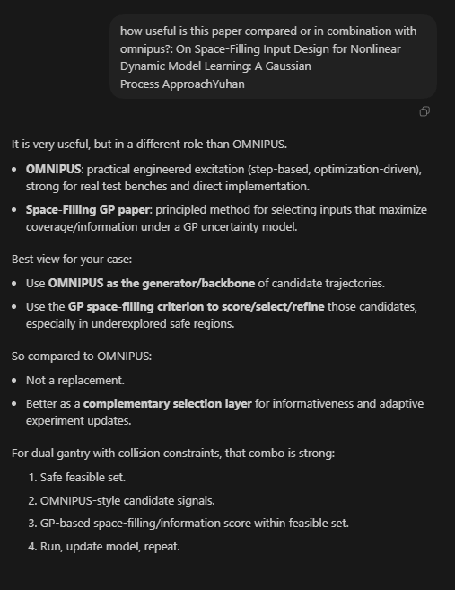
how useful is this paper compared or in combination with omnipus?: On Space-Filling Input Design for Nonlinear Dynamic Model Learning: A Gaussian Process ApproachYuhan

Slide 36
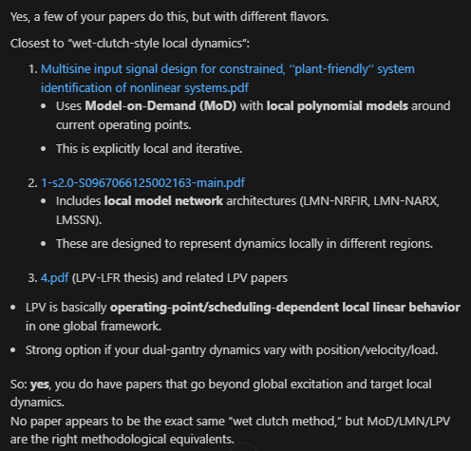
Similar to “Wet-Clutch trick”

Slide 37
Phase 1 Overview: Literature research
Deliverable Phase 1 ~6 weeks
  1. Background and already obtained results in the topic
  2. Literature survey
  3. Research questions
  4. AI&ES relevance
  5. Research methods
  6. Expected outcomes of the project
  7. Time planning phase 2
Starting mockup. Will be focusing on 5. and 7.
  5. How are you going to answer your research questions? Provide a sufficient description of the research methods and materials you will use during your project so that your supervisor can assess the appropriateness of your research approach, methods and materials, and of the quality and reliability of your data. What resources will you use or require? If an external party, such as a company, is involved, state what you need from this external party.
Phase 2
  Start simple, adapt Hoekstra’s code to LPV and MIMO

Slide 38
Simulation - MIMO
Asked other PhD student for adapted MIMO code
Compared it to the code of Jan
To change the structure to MIMO have to change two lines of code
Important Encoder function:
  Neural network that estimates the initial latent state X0 of the state‑space model from a short history of measured data.
  Enables us to train a state‑space model from only input/output data (u,y)

Slide 39
Fix ny so the encoder input includes all output channels (MIMO)
  Before (public repo): modified_encoder_net.__init__ hardcoded
  self.ny = tuple() → treats output-history size as 0
  Easy way to not scale the encoder with the number of outputs (SISO only shortcut)
Effect: the network input size becomes nb*nu + na*ny instead of nb*nu + 0, so it matches the flattened ypast for ny>1
Optional: Instead of using custom encoder switch to imported one from DeepSI library (adapted for MIMO)

Slide 40
na is the number of past time steps you feed in, and ny is how many outputs you have at each time step.
For SISO, ny=1, so na*ny = na.
  Each past time step contributes 1 output value. With na time steps, you have na x 1 = na output numbers.
For MIMO, ny>1, so na*ny grows.
  Each past time step contributes multiple output values. With na time steps, you have na x ny output numbers.

Slide 41
Outline next week
Start writing mockup for Phase 1 deliverable
Simulation

